Slide 1

The Great PSA Testing Controversy
Does PSA Testing Do More Harm Than Good?
Associate Professor Anthony Lowe

Slide 2
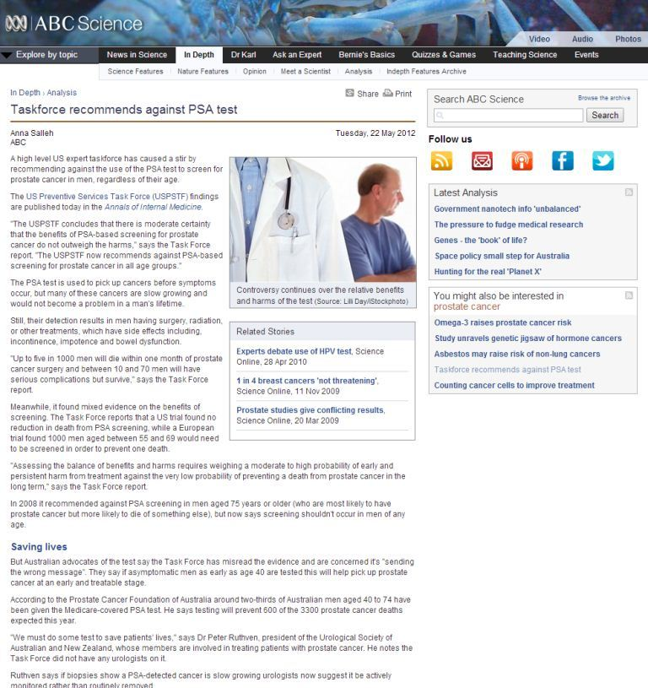
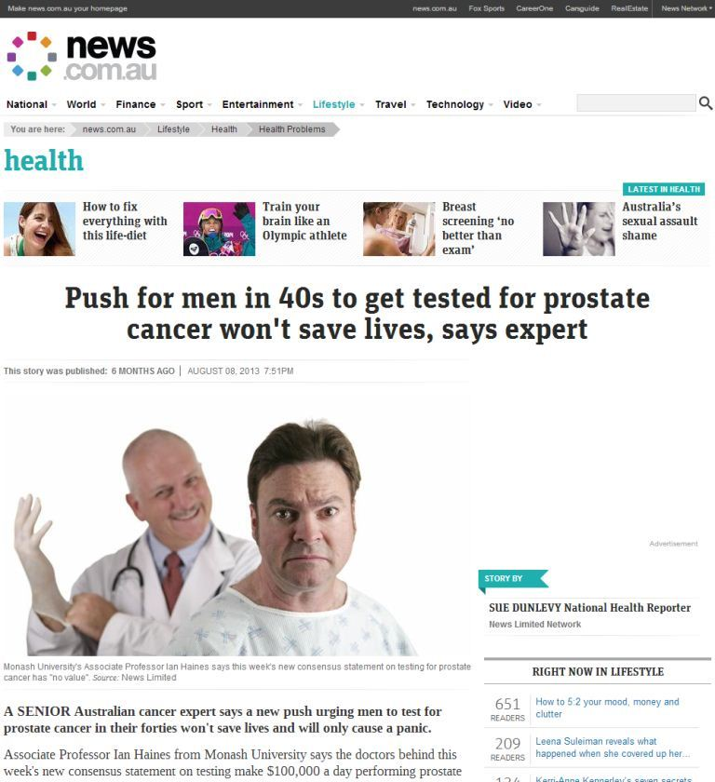
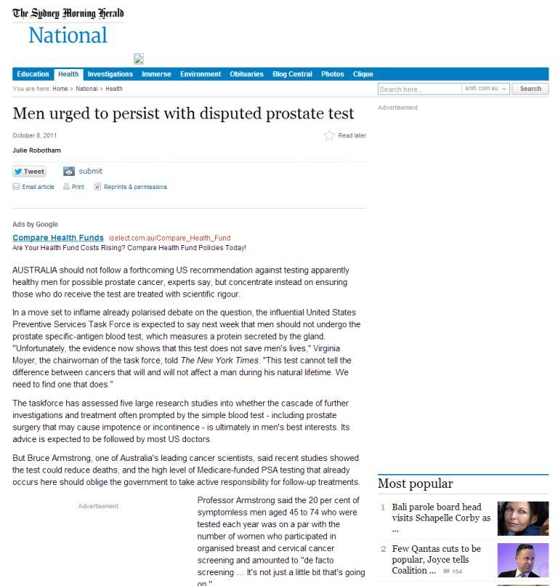
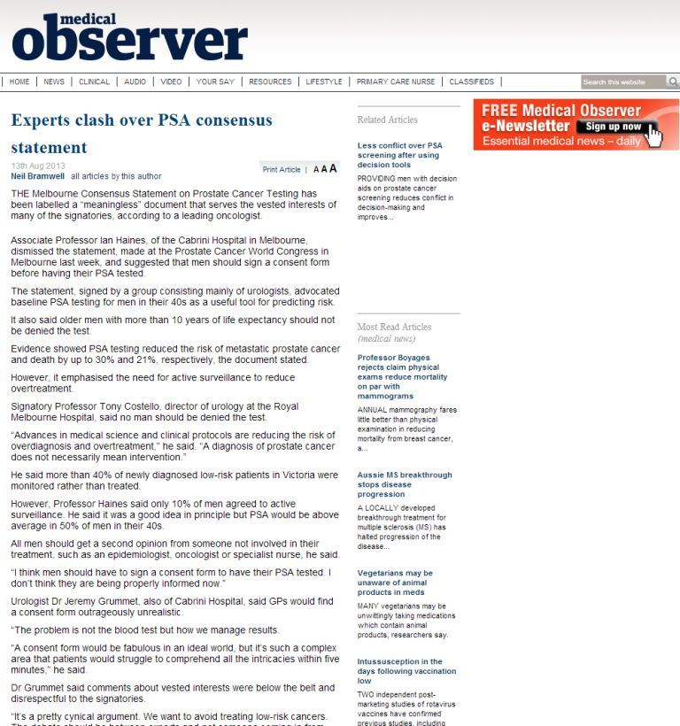
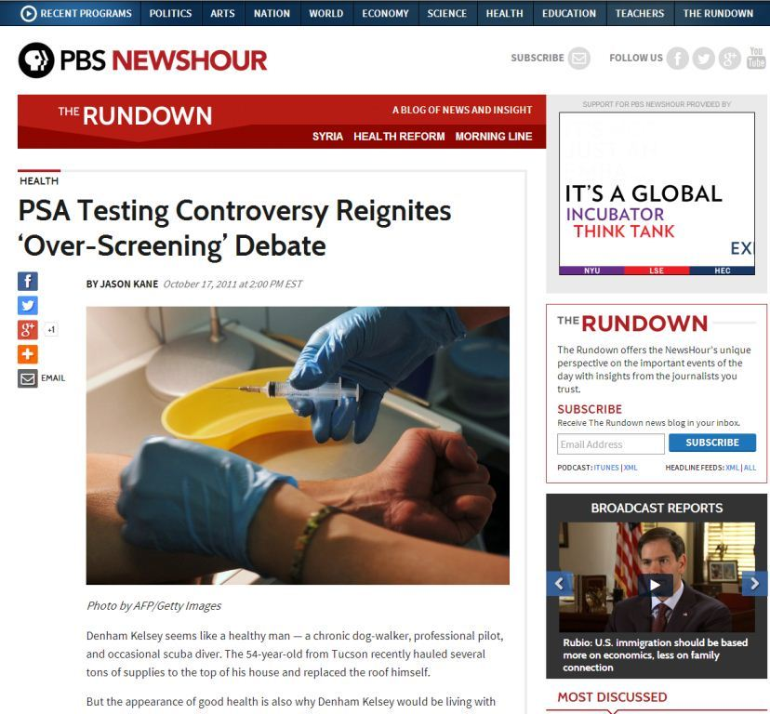
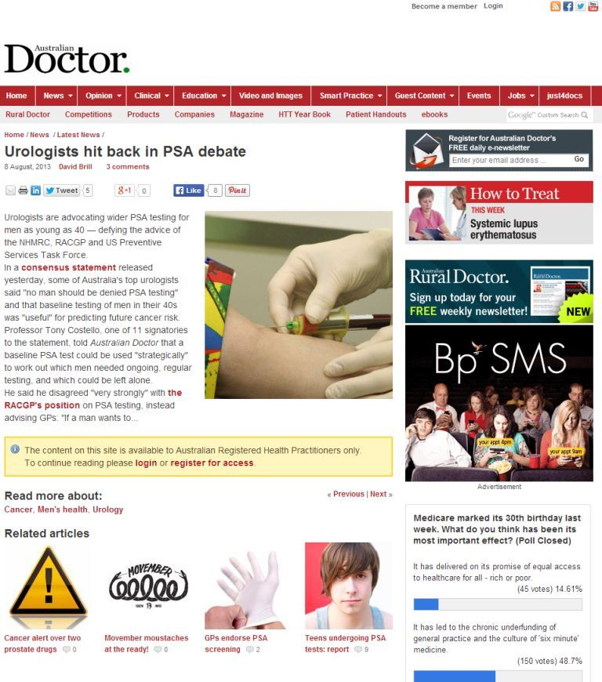

Slide 3
In this talk I will use
PSA testing
as shorthand for
PSA testing (with or without DRE) and subsequent prostate biopsy

Slide 4
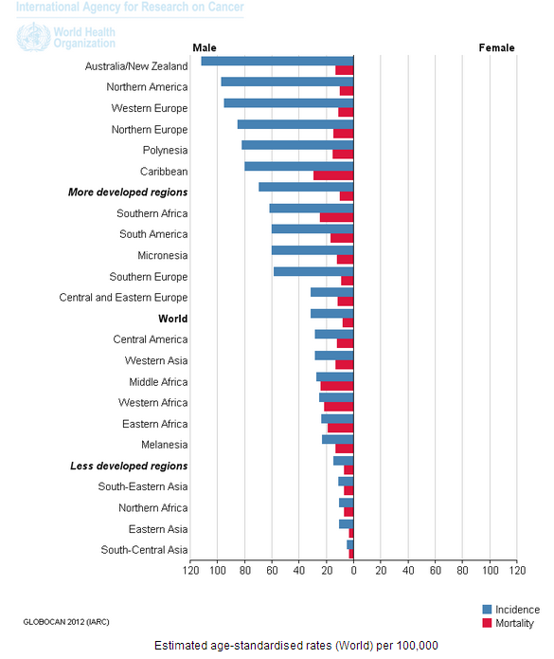
Sobering Statistics for Australians

Slide 5
Why the Controversy?
Surely early detection → early treatment → lives saved?
Unfortunately, not necessarily true, US study* has shown that for men aged 65+ diagnosed with early stage prostate cancer death from heart disease was more common than death from prostate cancer
Does it matter if we cannot prove PSA testing saves lives? Why not do it anyway? What harm can it do?
*Ketchandji et al. J Am Geriatr Soc. 2009;57(1):24-30.

Slide 6
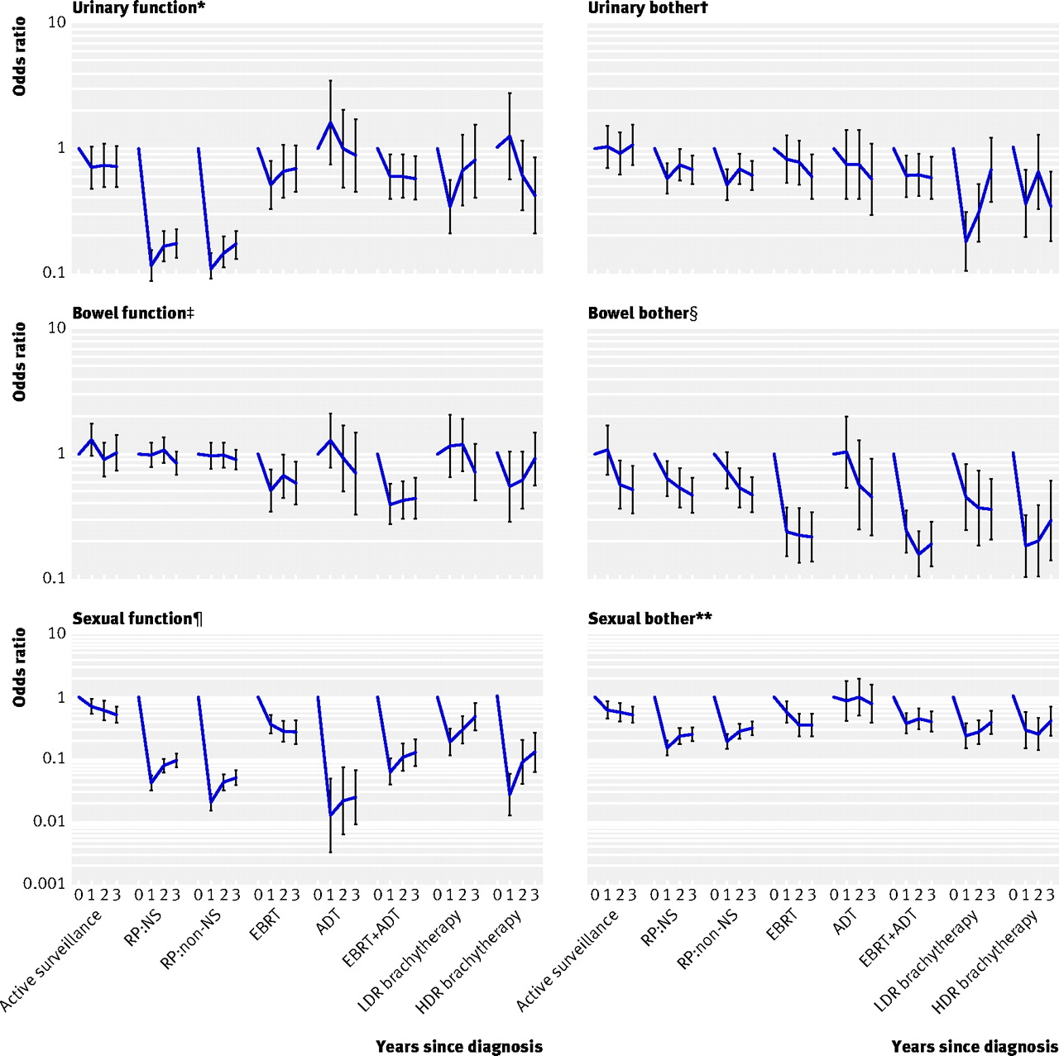
Harms from Treatment
Smith et al. BMJ 2009;339:b4817

Slide 7


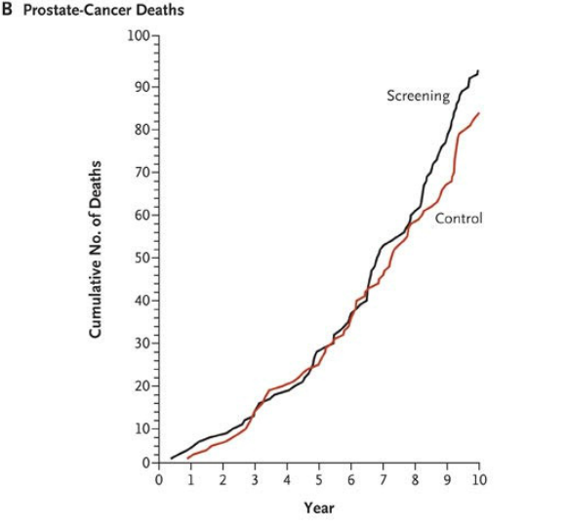
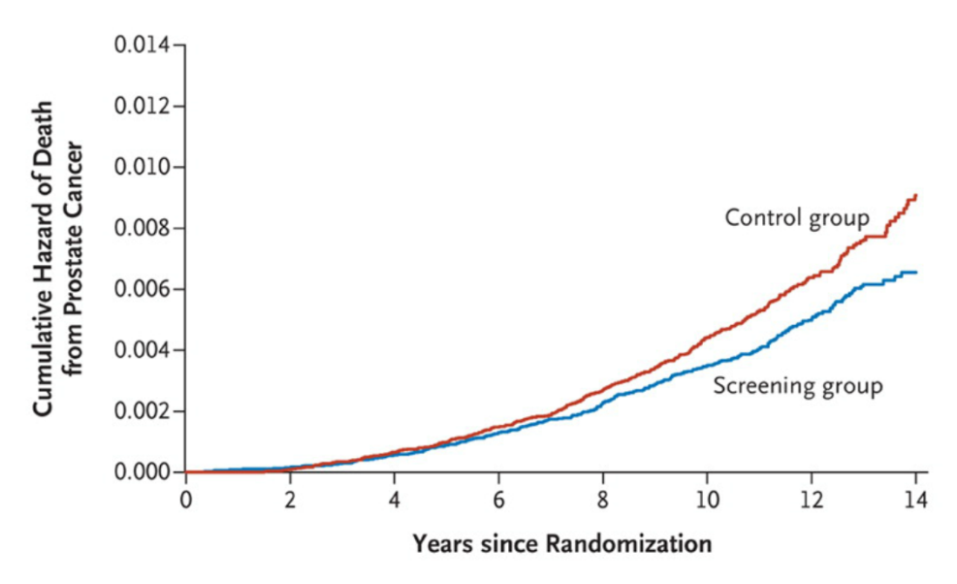
Benefits of Testing: PLCO and ERSPC
No reduction in deaths from prostate cancer
21% reduction in deaths from prostate cancer
31% reduction in risk of developing metastatic prostate cancer
No reduction in deaths from all causes
Andriole et al. N Engl J Med 2009; 360:1310-1319
Schroder et al. N Engl J Med 2012; 366:981-990

Slide 8
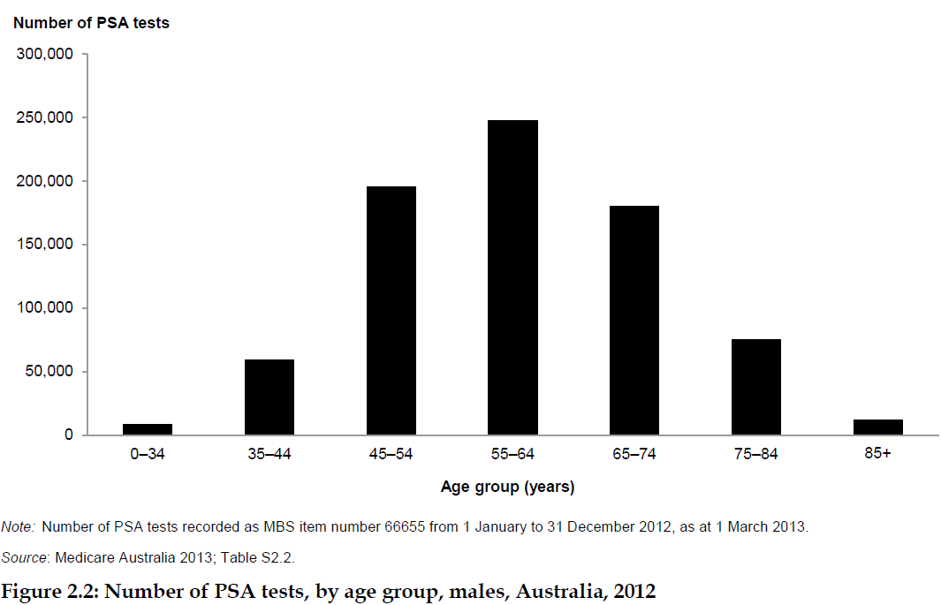
A Lot of PSA Testing is Occurring
778,469 PSA Screening Tests in 2012
Australian Institute of Health and Welfare 2013. Prostate Cancer in Australia. Cancer series no. 79. Cat. no. CAN 76. Canberra: AIHW.

Slide 9
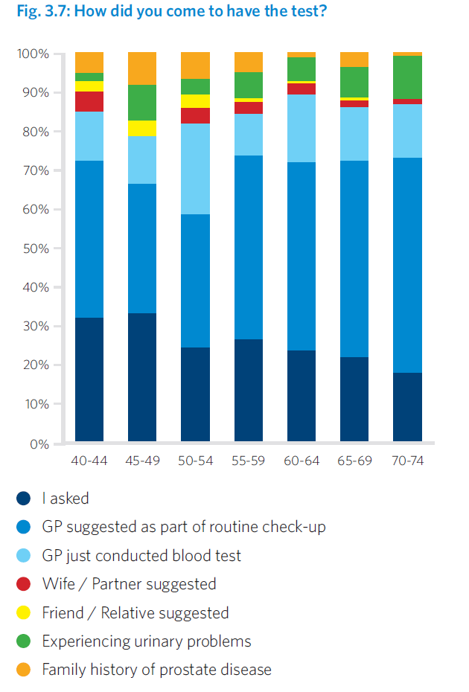
Self-reported Data* Indicate GPs are the Main Influencers for Men to be Tested
40% of participants in PCFA’s 2012 Community Attitudes Survey either “strongly agreed” or “agreed” that the advice about the usefulness of the test is confusing
*Lowe et al. 2012. Research, Awareness, Support: Ten Years of Progress in Prostate Cancer, PCFA.

Slide 10
What a Mess!
Evidenced-based medicine is hard when the evidence is inconclusive or non-existent
The Australian community is confused about PSA testing
Despite that large numbers of men are being tested with GPs as the main influencers

Slide 11
The Way Forward
Change the question from
Should we test or not?
↓
How do we create a more ordered approach that maximises the benefits and minimises the harms from testing and subsequent treatment?

Slide 12
Recent Advances
NHMRC Review
PRIAS and active surveillance
Melbourne Consensus Statement
PCFA-CCA national clinical guidelines on PSA testing and early management of test-detected prostate cancer

Slide 13
Melbourne Consensus Statement
For men aged 50–69, level 1 evidence demonstrates that PSA testing reduces prostate cancer-specific mortality and the incidence of metastatic prostate cancer
Prostate cancer diagnosis must be uncoupled from prostate cancer intervention
PSA testing should not be considered on its own, but rather as part of a multivariable approach to early prostate cancer detection

Slide 14
Melbourne Consensus Statement
Baseline PSA testing for men in their 40s is useful for predicting the future risk of prostate cancer
Older men in good health with over ten year life expectancy should not be denied PSA testing on the basis of their age

Slide 15
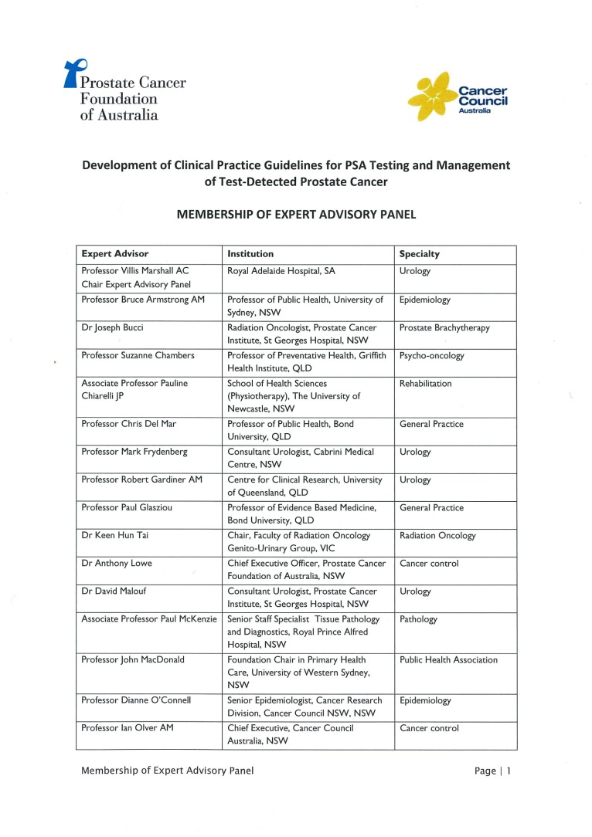
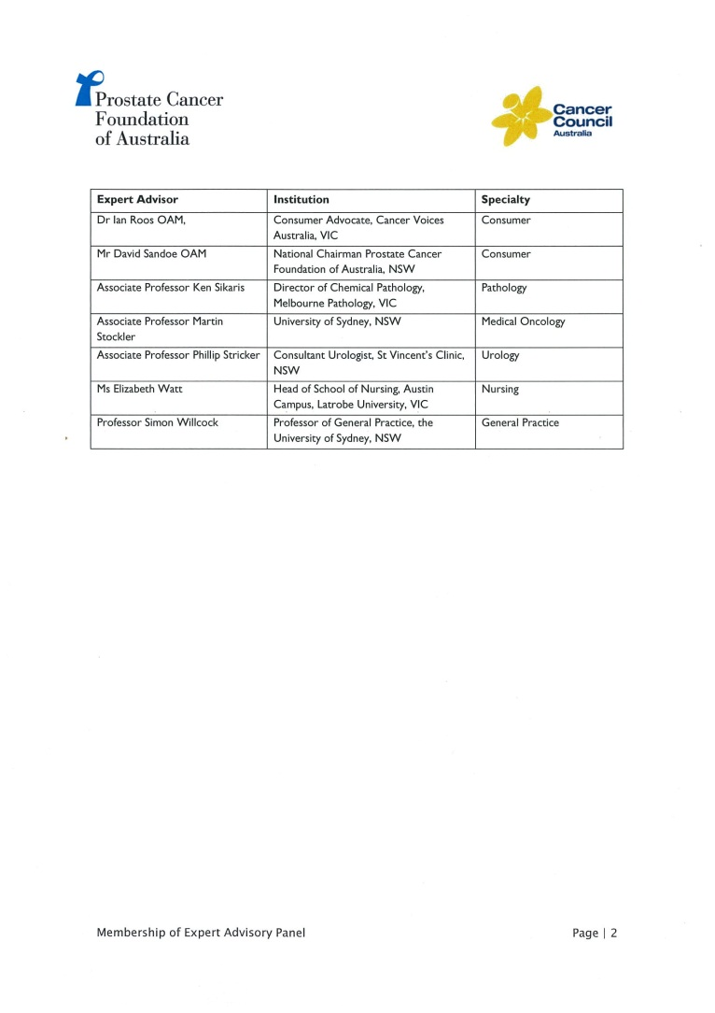
National Clinical Guidelines
Joint initiative of PCFA and Cancer Council Australia
Developing to NHMRC standard on CCA wiki platform
EAP includes full spectrum of opinion on PSA testing
Plan to launch at UICC World Cancer Congress in Melbourne in December
National and international first

Slide 16
PCFA Policy on PSA Testing
Men over age 50, or 40 with a family history of prostate cancer, should talk to their doctor about testing for prostate cancer using the PSA test and DRE as part of their annual health check-up. Men should make an individual informed decision about testing based on the latest available evidence on the benefits and potential harms of testing and subsequent treatment for prostate cancer.

